Slide 1
Hotel Booking Cancellation & Revenue Analytics
SCTP ASSOCIATE DATA ANALYST – CAPSTONE PROJECT
Business analysis and predictive modelling of 119,390 bookings · 1 X City Hotel & 1 X Resort Hotel · Jul 2015 – Aug 2017
By: Atticus Poh Tze Ping
Notes:
Introduce yourself and the project. This project analyses two years of hotel booking data to understand cancellations and revenue, and builds a model that predicts which bookings will cancel.

Slide 2
Business Context
The Hotel Booking Analytics dataset captures reservation activity across hotels, customers, market
segments, and booking outcomes. The dataset is designed to support hospitality analytics, revenue
management, occupancy analysis, customer behavior analysis, and reservation performance monitoring. By
combining booking transactions with hotel, customer, market segment, and reservation status information,
analysts can evaluate booking patterns, cancellation behavior, guest preferences, distribution channel
effectiveness, and overall hotel performance.
Notes:
Read the problem statement. Emphasise that 37 percent of bookings cancel, and that 16.7 million in booked room value was lost. The business needs to know which bookings are risky and which channels and guests are reliable.

Slide 3
Data Set Used
Table | Rows | Columns | What it holds | Link to Bookings
Bookings | 119,390 | 28 | One row per booking | —
Hotels | 2 | 2 | Resort Hotel, City Hotel | Hotel_ID
Market_Segments | 26 | 3 | Market segment + distribution channel combinations | Market_Segment_ID
Customer_Types | 36 | 4 | Customer type + deposit type + meal plan combinations | Customer_Type_ID
Reservation_Status | 3 | 2 | Check-Out, Canceled, No-Show | Reservation_ID
All IDs match, so joining the tables keeps every booking (119,390 rows × 35 columns).
Notes:
Read the problem statement. Emphasise that 37 percent of bookings cancel, and that 16.7 million in booked room value was lost. The business needs to know which bookings are risky and which channels and guests are reliable.

Slide 4
Problem statement
37%
Two hotels received 119,390 bookings between July 2015 and August 2017, and more than a third were cancelled.
Cancellations leave rooms empty at short notice; distort demand forecasts and cost revenue the hotels had already counted on.
Management does not know which bookings are most likely to cancel, which channels and guest types bring the most reliable revenue, or how pricing interacts with demand and cancellation.
Goal: measure the problem, find its drivers, and predict high-risk bookings early so the hotels can act.
of bookings were cancelled
16.7M
booked room value lost (39% of total)
Notes:
Read the problem statement. Emphasise that 37 percent of bookings cancel, and that 16.7 million in booked room value was lost. The business needs to know which bookings are risky and which channels and guests are reliable.

Slide 5
Research objectives
1
Booking & cancellation performance
2
Factors linked to cancellation
3
Market segments & channels
Volume, cancellation rate, ADR, revenue lost. City vs Resort; by year, month, season.
Lead time, deposit, previous cancellations, changes, requests, waiting list, parking.
Cancellation, ADR and revenue for Online TA, Offline TA/TO, Groups, Direct, Corporate.
4
Customer types & guest behaviour
5
Pricing & demand patterns
M
Predictive model (supports 2)
Customer type, repeat vs first-time, meal plan, party make-up, country.
ADR by hotel, month, demand and length of stay; price vs cancellation.
Classify each booking's probability of cancellation at booking time.
Notes:
Walk through each objective. Objectives 1 to 5 are business analysis; the predictive model supports objective 2 by turning the cancellation drivers into a risk score.

Slide 6
Data preparation: quality issues and decisions
Issue | Rows | Decision
children missing | 4 | Fill with 0
country missing | 488 | Label “Unknown”
agent / company missing | 16,340 / 112,593 | Fill 0 + has_agent / has_company flags
0 guests or 0 nights | 180 / 715 | Drop (not a valid stay) – real booking need to have 1 guest or more
ADR < 0 or ADR = 5,400 | 2 | Drop (entry errors) – Outliers (too far off the normal ADR)
Undefined market segment | 2 | Drop
Exact duplicate rows | ~32,000 | Keep for analysis; remove for modelling
reservation_status (+ date) | all | Exclude from model (leaks outcome)
118,561
clean bookings (0.7% removed)
15+
engineered features: season, total nights, party type, booking value, lost revenue, lead-time bands…
Saved as data/processed/bookings_clean.csv
Notes:
Explain each cleaning decision. Only 829 rows, 0.7 percent, were removed. The key judgement call is the 32 thousand duplicate rows: kept for business analysis because they are real block bookings, removed before modelling to prevent train-test leakage. Reservation status fields were excluded from the model because they are the outcome.

Slide 7
Objective 1: Overall booking and cancellation performance
The City Hotel cancels 42% of bookings, against 28% at the Resort
118,561
37.3%
102.5
26.0M
16.7M
bookings
cancellation rate
average daily rate (ADR)
realised revenue
lost to cancellations
 | Bookings | Cancel rate | ADR | Realised | Lost | % value lost
City Hotel | 78,896 | 41.9% | 105.8 | 14.4M | 10.9M | 43%
Resort Hotel | 39,665 | 28.0% | 95.9 | 11.6M | 5.8M | 33%
Summary
The City Hotel accounts for 65% of the value lost (10.9M of 16.7M).
Like-for-like Jan–Aug, 2017 grew bookings +11% and ADR +15% over 2016, but the cancellation rate also rose (35% → 39%). The problem is getting worse.
Notes:
Headline KPIs. The City Hotel takes two thirds of bookings and cancels much more often, so it accounts for 10.9 million of the 16.7 million lost.

Slide 8
Objective 2: Booking factors linked to cancellations
The longer the lead time, the more likely a cancellation of a Hotel Bookings
Notes:
Lead time is the clearest gradient: from under 10 percent for last-minute bookings to over two thirds for bookings made a year ahead. Median lead time is 113 days for cancelled bookings versus 46 for kept ones. On the right, Cramér's V ranks the strength of each factor.

Slide 9
Investigation: Non-Refund bookings cancel 99% of the time
 | Non-Refund | No Deposit
Bookings | 14,586 | 103,813
Cancellation rate | 99.4% | 28.6%
From Portugal | 97% | 33%
Groups / Offline TA | 97% | 28%
Median lead time | 183 days | 57 days
Has special requests | 0.2% | 47%
Duplicate rows | 93% | 19%
What it means
These look like tour-operator / agency block reservations released in bulk, or a deposit-type coding error. They do not look like individual guests cancelling.
The Groups segment (61% cancellation) is the same effect: 63% of Non-Refund bookings are Groups.
Action: audit whether deposits were really collected, and record released blocks separately from guest cancellations.
Notes:
This is counter-intuitive: guests who paid a non-refundable deposit should rarely cancel. The profile shows these are not normal guest bookings. Nearly all are Portuguese agency or group block bookings, and 93 percent are identical copies of another row. The most likely explanation is agency blocks released in bulk, or a deposit coding error. Group's 61 percent rate is the same effect.

Slide 10
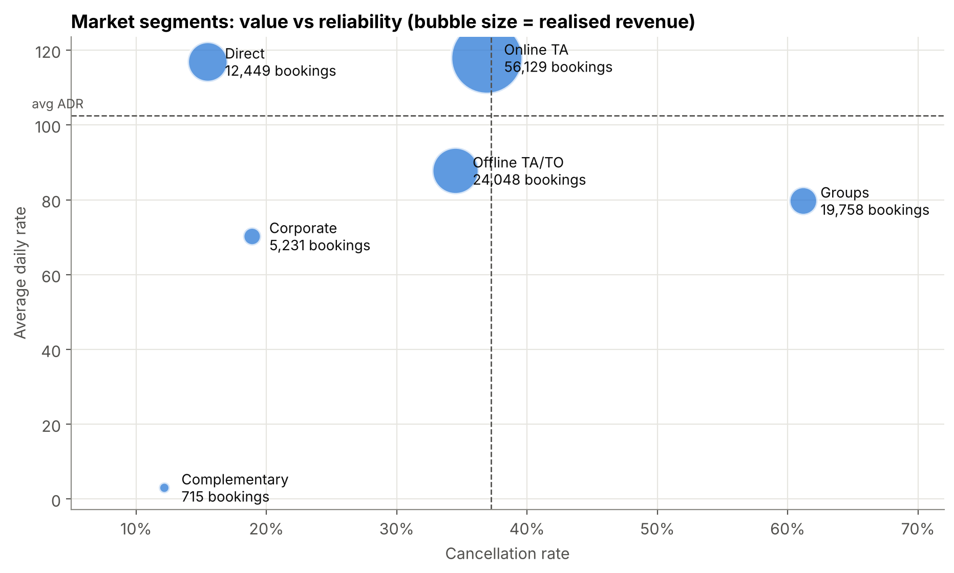
Objective 3: Market segments and distribution channels
Online TA brings the most revenue; Direct the most reliable bookings
Segment scorecard
Online TA: 53% of revenue, ADR 118, but 37% cancel
Direct: ADR 117 with only 15% cancel, the best-quality segment
Corporate: reliable (19%) but low ADR (70)
Offline TA/TO: mid risk (35%), mid price (88)
Groups: 61% cancel, ADR 80
Channel: TA/TO = 82% of bookings, 41% cancel; Direct channel 18%
Notes:
Bubble chart: x is cancellation rate, y is ADR, bubble size is realised revenue. The ideal quadrant is top-left: high price, low cancellation. Direct sits there. Online TA is high value but at average risk. Groups sit bottom-right: low price, high risk.

Slide 11
Objective 4: Customer types and guest behaviour
Repeat guests cancel less than half as often as first-time guests
Guest profile insights
Transient guests: 75% of bookings, 41% cancel. Group type: 10%.
Repeat guests: 16% vs 38%. Median lead time 4 days; 62% book Direct/Corporate. Only 3% of guests are repeat guests.
Couples cancel most (40%), solo adults least (29%). Families pay the highest ADR (~155).
Portugal: 57% vs 17–26% for UK, France, Germany, Spain.
Notes:
Transient individual guests are 75 percent of volume and the riskiest. Repeat guests cancel 16 percent versus 38 percent for first-timers, but they are only 3 percent of bookings, so there is a big loyalty opportunity. Portugal, the domestic market, cancels 57 percent, largely the block-booking effect.

Slide 12
Objective 5: Pricing and demand patterns
Resort prices nearly quadruple in August; City prices follow demand
Insights
Resort: ×3.7 from ~50 (Jan/Nov) to 183 (Aug). It is a seasonal premium, since monthly volume barely changes (ADR vs demand r = 0.29).
City: flatter (83–122) but tightly linked to demand (r = 0.80).
ADR rises with stay length up to 8–14 nights, then drops for 15+ nights. One-night Resort stays are the cheapest (~76).
Notes:
ADR of stays that actually happened, by month. The Resort charges about 50 in winter and 183 in August, a seasonal holiday premium. The City Hotel ranges from 83 to 122, and its monthly ADR correlates 0.80 with booking demand, against only 0.29 at the Resort.

Slide 13
Modelling approach
Target
is_canceled (28% positive after de-duplication)
Features
26 booking-time fields: lead time, deposit, segment, country, ADR, requests…
1
2
No leakage
Excluded reservation status/date; removed ~33k duplicate rows before split
Split
Stratified 80/20 · 68,500 train / 17,125 test · 5-fold CV
3
4
Models
Baseline · Logistic Regression · Decision Tree · Random Forest · Gradient Boosting
Metrics
ROC-AUC (ranking), recall (catch cancellations), precision, F1
5
6
Notes:
Key points: only features known at booking time; duplicates removed before splitting to prevent leakage; stratified 80/20 split; 5-fold cross-validation; five models compared, from a simple baseline to ensembles.

Slide 14
Random Forest is the best model, with a test ROC-AUC of 0.90
Model | CV AUC | Test AUC | Accuracy | Precision | Recall | F1
Baseline | 0.500 | 0.500 | 0.720 | 0.000 | 0.000 | 0.000
Logistic Regression | 0.830 | 0.829 | 0.739 | 0.523 | 0.764 | 0.621
Decision Tree | 0.858 | 0.858 | 0.769 | 0.563 | 0.775 | 0.652
Random Forest | 0.892 | 0.896 | 0.818 | 0.641 | 0.788 | 0.707
Gradient Boosting | 0.890 | 0.894 | 0.800 | 0.605 | 0.820 | 0.696
Baseline: 72% accuracy but 0 cancellations caught, so accuracy alone misleads.
Random Forest catches 79% of cancellations with 64% precision.
Robust: AUC 0.88 without parking; 0.80 when trained on 2015–16 and tested in 2017.
Notes:
The baseline gets 72 percent accuracy by always predicting kept, but catches zero cancellations. That's why accuracy alone is misleading. Random Forest has the best AUC, accuracy and F1; Gradient Boosting is a close second with slightly higher recall.

Slide 15
Recommendations
Audit Non-Refund & agency blocks
Confirm deposits are collected; record released blocks separately (99% “cancel”).
Tighten group contracts
Release dates, attrition clauses, staged deposits (Groups 61%).
1
2
Score every new booking
Use the model's risk tiers to target deposits & reminders (AUC 0.90).
Controlled overbooking
City Hotel, Apr–Jun peaks, sized by predicted cancellations (~45%).
3
4
Lead-time policy
Re-confirm or stricter terms for bookings 90+ days out (45–68% cancel).
Grow direct & repeat business
Loyalty perks, best-rate guarantee (Direct 15%, repeat 16%).
5
6
Engage guests at booking
Prompt for requests and preferences (48% → ≤22% cancel).
Smarter pricing
Keep Resort summer premium with min-stay rules; demand pricing at City; deposits on 15+ nights.
7
8
Orange = highest-impact priorities
Notes:
Eight actions linked to the evidence. The first three have the biggest impact: fix the data and process issue with block bookings, tighten group contracts, and put the model into operation.

Slide 16
Key takeaways
Limitations
Only two hotels in one country, so results may not generalize.
Partial years: 2015 (Jul–Dec) and 2017 (Jan–Aug).
Data do not state the reasons for cancelling, thus unable to do service recovery.
37% of bookings cancel, costing 16.7M (39% of booked value), and the rate is rising.
Lead time, deposit type, segment and guest engagement are the strongest signals.
Direct and repeat guests are the most reliable; Groups and Non-Refund blocks the least.
A Random Forest model (AUC 0.90) can target the ~26% of bookings that cancel 72% of the time.
Thank you ·
Q & A?
Notes:
Summarise the four takeaways and invite questions.

